Slide 1
MongoDB - Drop Database
This will delete the selected database. If you have not selected any database, then it will delete default 'test' database.
Syntax
db.dropDatabase()
Commands
>use employeedb
>db
>show dbs
>db.dropDatabase()

Slide 2
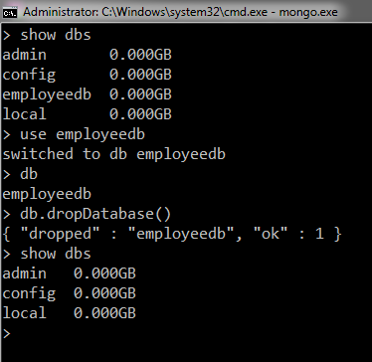
MongoDB - Drop Database

